Slide 1
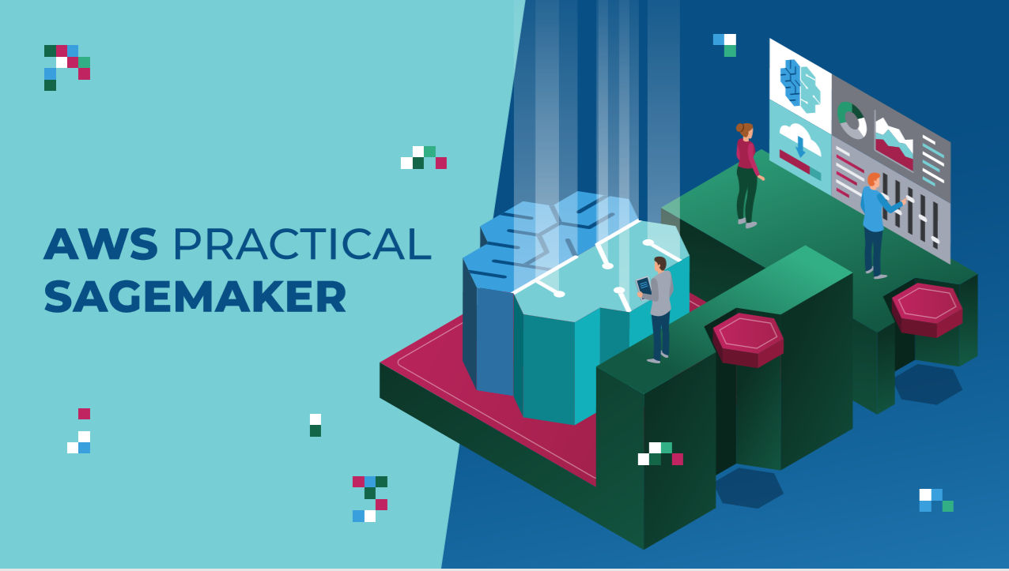

Slide 2
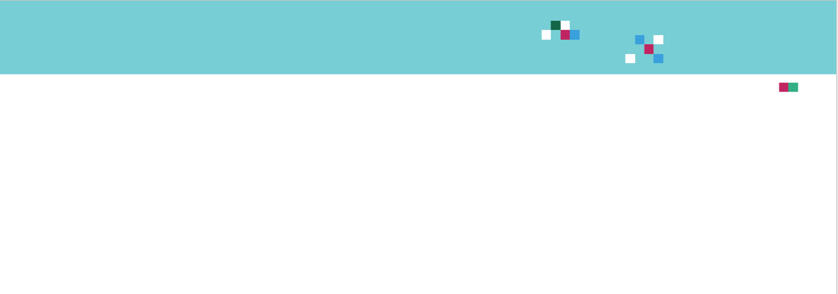
COURSE OUTLINE
CASE STUDY #1: EMPLOYEE SALARY PREDICTIONS
CASE STUDY #2: MEDICAL INSURANCE PREMIUMS PREDICTION
CASE STUDY #3:
RETAIL SALES PREDICTIONS
CASE STUDY #4: CARDIOVASCULAR DISEASE PREDICTIONS
CASE STUDY #5: IMAGE CLASSIFICATION AND DEEP LEARNING
CASE STUDY #6: SAGEMAKER STUDIO DEEPDIVE & AUTOML

Slide 3
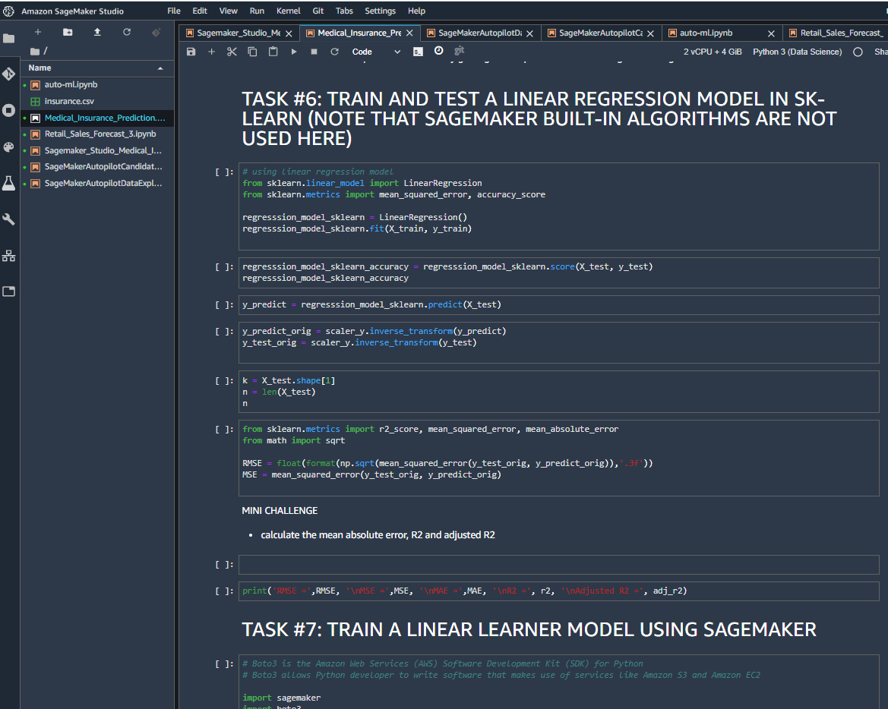
JUPYTER NOTEBOOKS WALKTHROUGH:
SEVERAL MINI CHALLENGES/PRACTICE ACTIVITIES
BRAND NEW AWS SAGEMAKER STUDIO
CASE STUDIES ARE DIVIDED INTO SMALL MANAGEABLE TASKS

Slide 4
CASE STUDY #1: KEY LEARNING OUTCOMES
PREDICT EMPLOYEE SALARY
Understand how to leverage the power of machine learning to predict employees salary based on the number of years of experience.
Understand the theory behind simple linear regression and sum of least squares.
Train a simple linear regression model using Scikit Learn.
Load and manipulate dataset using pandas data frame.
Divide dataset into training and testing using scikit learn.
Preform exploratory data analysis and visualization using histograms, Seaborn pairplot, matplotlib and correlation matrices.
Understand the basics of SageMaker Studio.
Upload data to S3 using Boto3 AWS SDK.
Understand the concepts of containers, Identity and Access Management (IAM), and Elastic Inference.
Train a Linear Learner model to preform regression tasks using AWS SageMaker.
Deploy and test trained model and perform inference.
ABSOLUTE BEGINNER CASE STUDY + SIMPLE DATASET + REGRESSION + SKLEARN + S3 + LINEAR LEARNER + MODEL DEPLOYMENT + ENDPOINT INFERENCE

Slide 5
CASE STUDY #2: KEY LEARNING OUTCOMES
PREDICT MEDICAL INSURANCE PREMUIM
Predict medical insurance premium based on individual’s features such as age, BMI, smoking habits and location.
Apply lambda function in python and convert categorical variable into dummy/indicator variables.
Fit a straight line to dataset using seaborn regplot.
Perform feature scaling using sklearn.
Understand the theory and intuition behind multiple linear regression.
Understand the theory and intuition behind artificial neural networks and how to apply them to perform regression tasks.
Learn the difference between various regression KPIs such as RMSE, MSE, MAE, coefficient of determination (R2) and adjusted R2.
Build, train and deploy a predictive model using SageMaker built-in Linear Learner.
Build and train artificial neural networks models using Keras API with Tensorflow as backend.
Understand the difference between various activation functions such as Sigmoid, RELU, and tanh.
Understand the theory and intuition behind gradient descent and backpropagation algorithms.
MULTIPLE LINEAR REGRESSION + CATEGORICAL/NUMERICAL DATA + REGRESSION KPIS + ANNs + ACTIVATION FUNCTIONS + KERAS

Slide 6
CASE STUDY #3: KEY LEARNING OUTCOMES
RETAIL SALES PREDICTION
Develop a sales forecasting model to predict weekly retail store sales based on historical data.
Merge multiple Data Frames using pandas library.
Understand the concept of bias, variance, overfitting and underfitting.
Learn the difference between L1 and L2 regularization.
Develop a function in python and apply it to pandas dataframe.
Learn how to fill out missing data points (null elements).
Understand the concept of bias-variance trade-off.
Understand the theory and intuition behind gradient boosted trees and Extreme Gradient boosting (XGBoost) algorithm.
List the advantages and disadvantages of XGBoost algorithm.
Learn how to build a decision tree and decision tree ensemble.
Build, train and deploy XGBoost-based algorithm to perform regression tasks.
Deploy the best model after the hyperparameters optimization job is complete.
Optimize XGBoost hyperparameters using SageMaker’s Hyperparameters optimization tool.
RETAIL SALES PREDICTION + XGBOOST + BIAS VARIANCE + L1/L2 REGULARIZATION + HYPERPARAMETERS TUNING

Slide 7
CASE STUDY #4: KEY LEARNING OUTCOMES
CARDIOVASCULAR DISEASE PREDICTION
Detect the presence of cardiovascular disease in person based on the given features such as cholesterol levels, blood pressure, and physical activity.
Understand the intuition behind principal components analysis (PCA).
Apply PCA to perform dimensionality reduction using real world datasets.
Learn how to apply XGBoost algorithm in SageMaker to perform classification tasks using reduced features after XGBoost.
Evaluate classification models and present results using confusion matrix and classification reports.
Understand the difference between precision, recall, and F1-score.
Learn the difference between Receiver Operating Characteristics (ROC) and Area Under Curve (AUC).
Perform Grid search and optimize model parameters.
Deploy trained PCA algorithm using AWS SageMaker.
HEALTHCARE + PCA + XGBOOST CLASSIFICATION + TWO SEQUENTIAL AI/ML MODELS + CONFUSION MATRIX + PRECISION/RECALL/F1-SCORE + GRIDSEARCH

Slide 8
CASE STUDY #5: KEY LEARNING OUTCOMES
DEEP LEARNING FOR TRAFFIC SIGN CLASSIFICATION
Learn how to leverage the power of deep learning to perform image classification.
Understand the theory and intuition behind convolutional neural networks (CNNs).
Understand the theory and intuition behind LeNet deep neural networks.
Evaluate trained LeNet networks on testing data.
Know the difference between various activation functions such as Sigmoid and Rectified Linear Units (RELU).
Apply Keras API to build Deep Convolutional Neural Networks.
Train LeNet to perform image classification using real world datasets
Improve the model generalization capability using dropout regularization technique.
Learn how to use TensorFlow estimators from the Sagemaker SDK to build, train and deploy deep learning models.
DEEP LEARNING + IMAGE CLASSIFICATION + TENSORFLOW SDK + KERAS + CNNs + LENET

Slide 9
CASE STUDY #6: KEY LEARNING OUTCOMES
SAGEMAKER STUDIO AND AUTOML DEEPDIVE
Learn how to use SageMaker Studio AutoML tool.
Learn how to manage experiments in SageMaker studio.
Learn how to use the debugger tool to debug XGBoost models.
Generate and view candidate generation notebook and data exploration notebooks.
SAGEMAKER STUDIO + AUTOML + MODEL DEBUGGER + EXPERIMENTS MANAGEMENT + REPORT GENERATION

